Slide 1
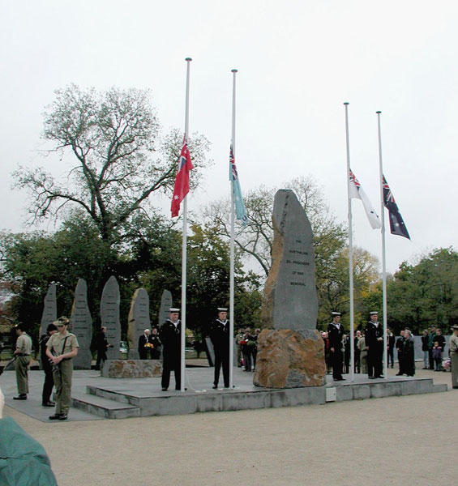
Australian Ex-Prisoners of War Memorial
The First Military Memorial of National Significance

Slide 2
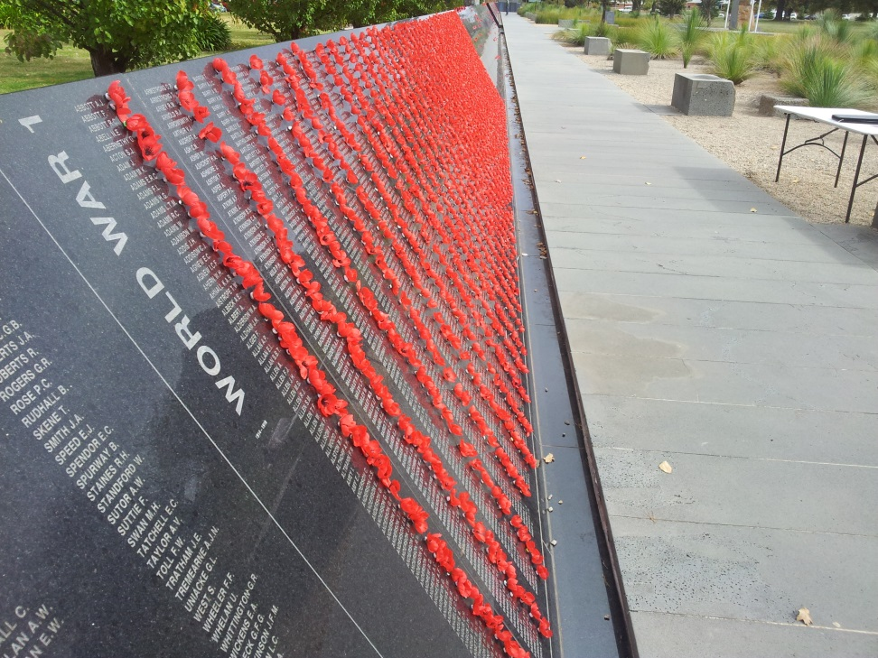
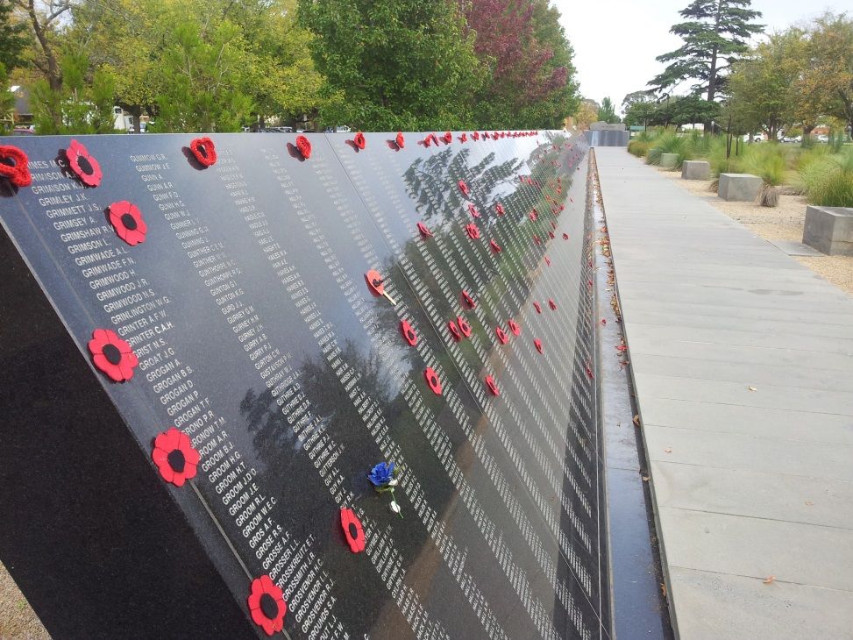
Australian Ex-Prisoners of War Memorial
Pleasant Street Primary School
Ballarat
Girl Guides

Slide 3
Australian Ex-Prisoners of War Memorial
David Alexander BAIRD AM
The Australian Ex-Prisoners of War Memorial Trustees
and former Committee Members mourn the loss of their good
friend and the past-Chairman of the Memorial Appeal.
David was an inspiration to all those he touched in his life and his wisdom, understanding and forgiving nature towards all men will not be forgotten.
Lest We Forget
Les Kennedy OAM
The Australian Ex-Prisoner of War Memorial Trustees
and former Committee Members mourn the loss of
their good friend and past Project Co-Ordinator of the
Memorial Appeal.
Les was an avid advocate for Prisoners of War and
the service community; a gentleman who saw much
and did more.
Lest We Forget

Slide 4
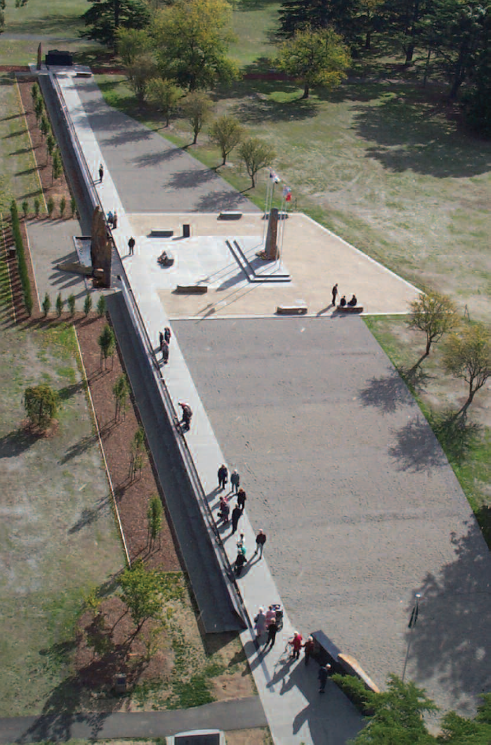

Slide 5
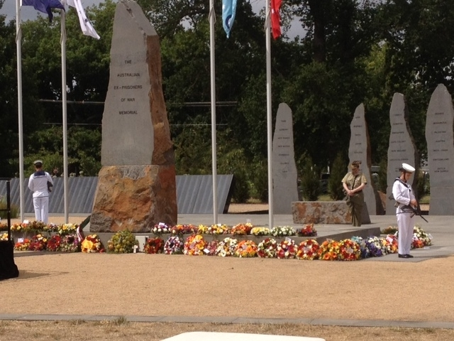
Australian Ex-Prisoners of War Memorial
6th February 2004
Opening Ceremony

Slide 6
Australian Ex-Prisoners of War Memorial
The First Military Memorial of National Significance

Slide 7
Australian Ex-Prisoners of War Memorial
Colenso Brothers

Slide 8
Australian Ex-Prisoners of War Memorial

Slide 9
Australian Ex-Prisoners of War Memorial

Slide 10

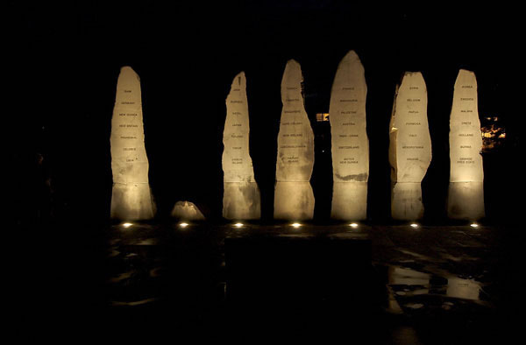
Australian Ex-Prisoners of War Memorial
The First Military Memorial of National Significance

